Slide 1
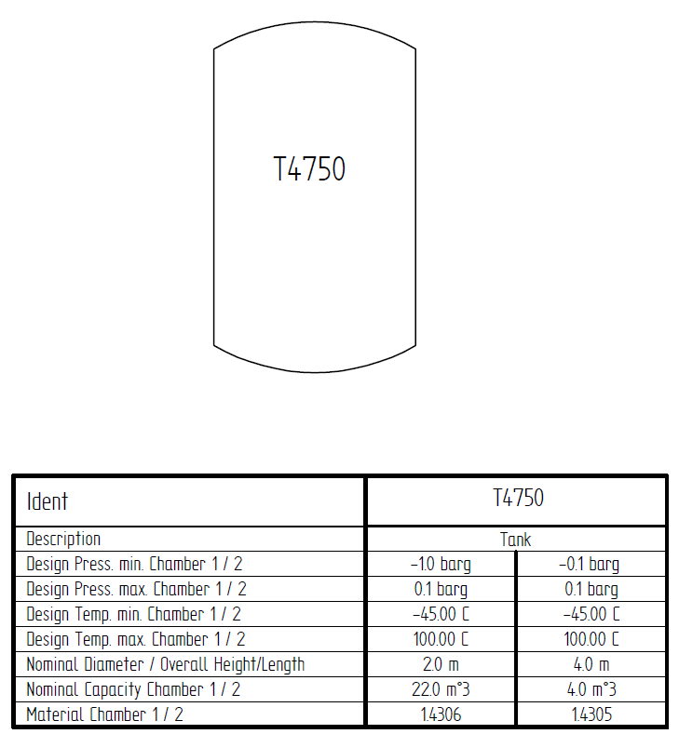
Test Case E01 – Tank T100

